Slide 1
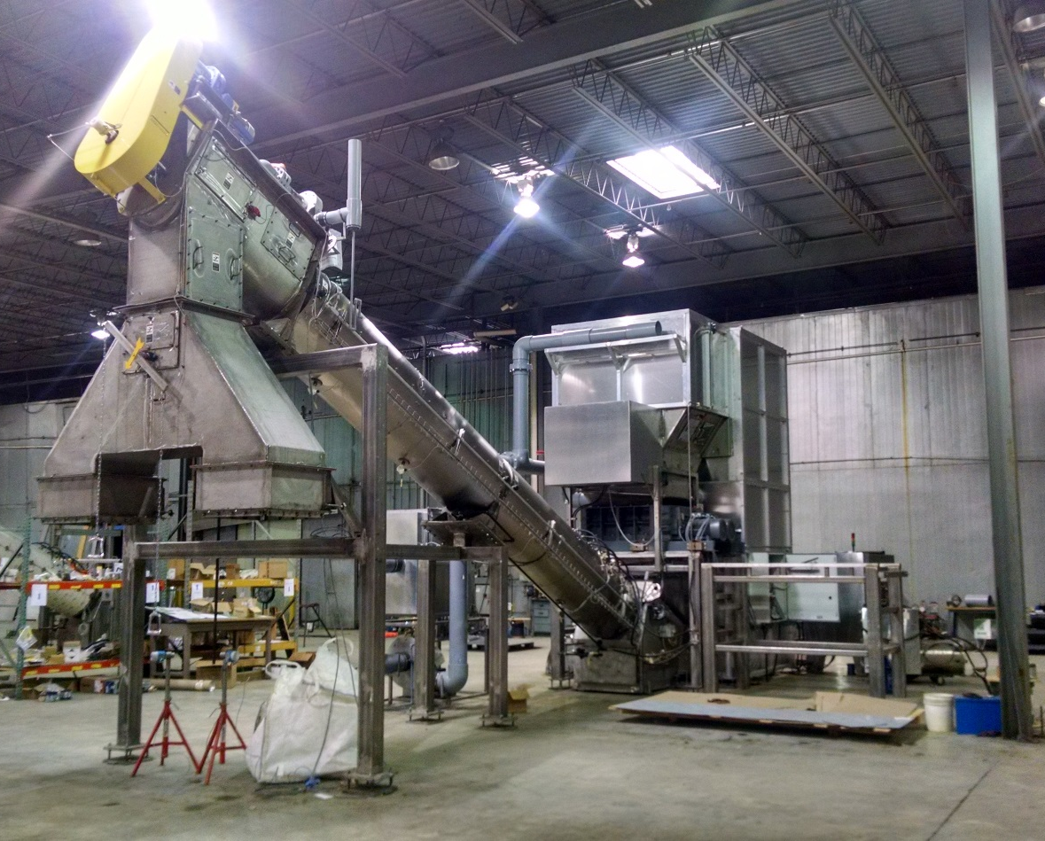
BioSAFE STI Series 2000
In-service Training Session
Frequently Asked Questions

Slide 2
Frequently Asked Questions:
Does the BioSAFE STI Series 2000 comply with the state regulations pertaining to RMW?
  Yes. If your state issues approval letters, STI will provide a copy to be filed.

Slide 3
Frequently Asked Questions:
Do any permits need to be applied for to use the system on-site at one or more of the facilities?
  Yes. Normally, the user must apply for on-site use by permit, or permit by rule.

Slide 4
Frequently Asked Questions:
Can the system be used to destroy confidential HIPPA documents?
  Yes. The BioSAFE STI Series 2000 is commonly used to shred confidential records instead of outsourcing to another company.

Slide 5
Frequently Asked Questions:
Is the system environmentally friendly?
  Yes. There is no air, water, or soil pollution associated with the STI Series 2000 system.

Slide 6
Frequently Asked Questions:
Does the system have to be manually loaded by an operator
  No. The system is completely automated. The operator is only required to roll the cart into the machine, and press one button.

Slide 7
Frequently Asked Questions:
Will the system require autoclave bags?
  No. The system will shred the medical waste, the waste bag and the cardboard containers (if used). Use waste compliant primary and secondary containers that suit the needs of the waste and facility.

Slide 8
Frequently Asked Questions:
How much chemical (sodium hypochlorite – bleach) is used in the system? What are the environmental impacts?
  After each cycle, a small pump turns on and dispenses a few mL of bleach with water for about 10 seconds through spray nozzles below the integral shredder. A gallon of bleach will last several days in a typical facility. If any odor is noticed, simply increase the amount of bleach and water solution.

Slide 9
Frequently Asked Questions:
What source treats the waste in the system?
  Low pressure steam.

Slide 10
Frequently Asked Questions:
Can the system be installed outside in extreme weather conditions?
  Yes. The system can be installed both indoors and outdoors. Where freezing is a concern, the system heat-traces and insulates plumbing interconnections that may come in contact with cold temperatures.

Slide 11
Frequently Asked Questions:
How long with the cutters last in the shredding chamber?
  BioSAFE estimates the cutters to last between 2-3 million pounds of throughput prior to replacement.

Slide 12
Frequently Asked Questions:
What is the life expectancy of the system?
  The system life expectancy is in term of pounds versus years. The first STI systems were installed in 1995 and to date, STI systems have successfully treated in excess of 2-Billion pounds of medical waste world wide

Slide 13
Frequently Asked Questions:
What is involved in the installation of the system?
  BioSAFE hires, directs, and pays a professional rigging crew, plumbers, electricians that are licensed in your state to assist with installation. The staffing will then be instructed and trained by BioSAFE on the proper operation and maintenance of the system. Upon completion of the training, BioSAFE will issue certificates of completion for the owners records.

Slide 14
BioSAFE STI Series 2000
Informational Training Outline

Slide 15
Informational Training Outline:
Introduction to RMW and OSHA guidelines
Personal Protective Equipment (PPE)
Chemical training – handling, use, MSDS (material safety data sheets) sheet(s)
Steam safety protocols, operation, and maintenance

Slide 16
Informational Training Outline: Con’t
Control panel functions and system controls
Pre-start check list
System controls
Periodic spore testing
Quality assurance program
Maintenance schedule
Troubleshooting techniques
Recommended spare parts

Slide 17
OSHA Guidelines FS209B1910
All body fluids shall be treated as dangerous
Always wear proper PPE includes but may not be limited to gloves, face shields, aprons, masks and booties
Hand washing immediately after handling
Replace gloves as soon as possible if compromised

Slide 18
Personal Protective Equipment (PPE)
PPE will be provided by your employer in the appropriate sizes
PPE is specialized clothing and/or equipment that protects the wearer
Examples of PPE include, gloves, shields, and masks
Effective PPE must not permit potentially infection materials to pass through or reach skin, eyes, mouth, or clothes.

Slide 19
Chemical Handling
Sodium Hypochlorite – Chlorine bleach
Never mix chlorine bleach with other cleaning products
Effective against bacteria, viruses, molds, and fungi
Spills – isolate and contain the spill to prevent spread

Slide 20
Low Pressure Steam Safety
Low pressure steam at 14.2 PSIG or less
Temperature does not exceed 250° F
Auger direct steam impingement temperatures average 205 °F -212°F depending upon the elevation above sea level
Auger steam jacket temperatures have a maximum operating range up to 245 ° F

Slide 21
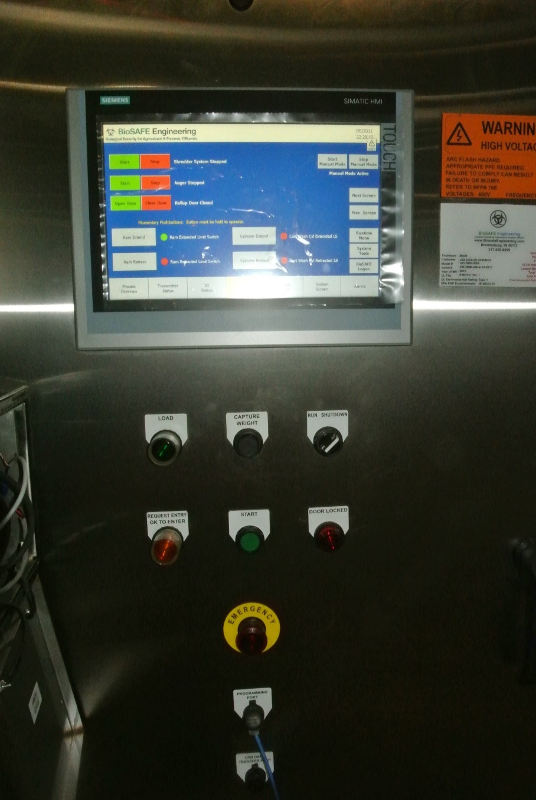
Control Panel Controls
Load
Capture Weight
Request Entry OK to Enter
Start
Emergency Stop
Door locked

Slide 22
Control Panel Controls
E-Stop – must be pulled out for machine to operate
Start – starts the unit
Capture Weight - stores the weight of the waste
Load – flashes green when unit is ready to load

Slide 23
Pre-start Check List
PPE equipment is required
Ensure all access doors and ports are closed and secured
Turn on main fused disconnect and system disconnects
Main power should be energized
Hydraulic pump should be serviced and ready to operate
Energized hydraulic compactor
Ensure there are no active alarms on the control panel

Slide 24
System Controls Start Up
Set to run and push start
Ensure manual valve is open to let the system warm up
HEPA blower and auger will start
Shredder clean out mode will initiate
Roll container onto scale and capture weight
Roll container into dump bucket
Exit loading area and press load

Slide 25
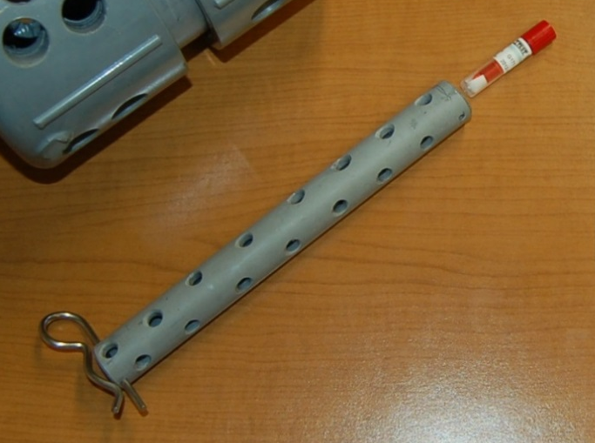
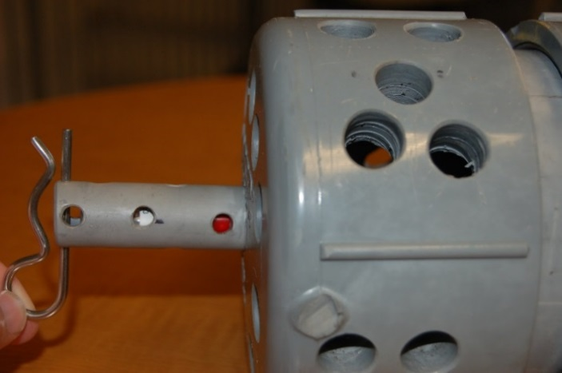
Spore Testing
Eggs – Perforated PVC spore test containers
SCBI’s – Self Contained Biological Indicators
  Bacillis Atrophaeus Spore
Load SCBI’s into tube as shown
  Caps facing out
Lock into place with pins

Slide 26
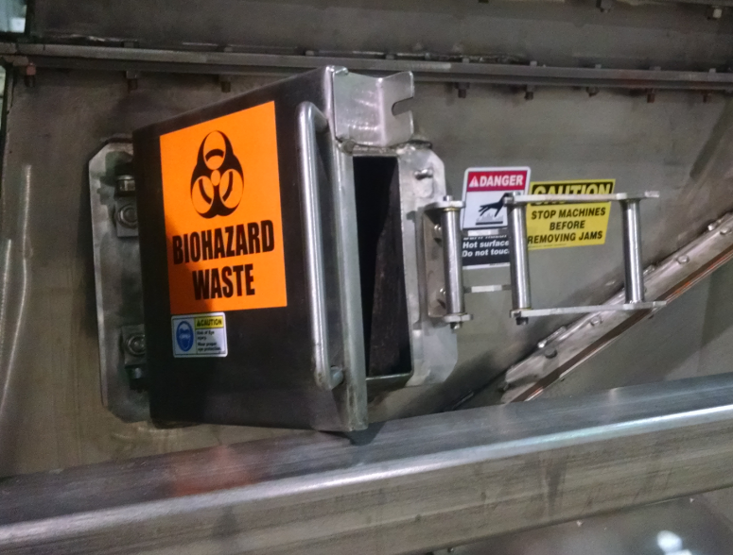
Spore Testing
Put on PPE
Place the egg into the hatch
Hatch is located in the inlet (bottom) of the auger
Place spore test retrieval grate in the discharge end of the auger
Egg should take a minimum of 60 minutes to travel through the system
Wearing recommended PPE, collect spore test egg when it exits the steam treatment auger

Slide 27
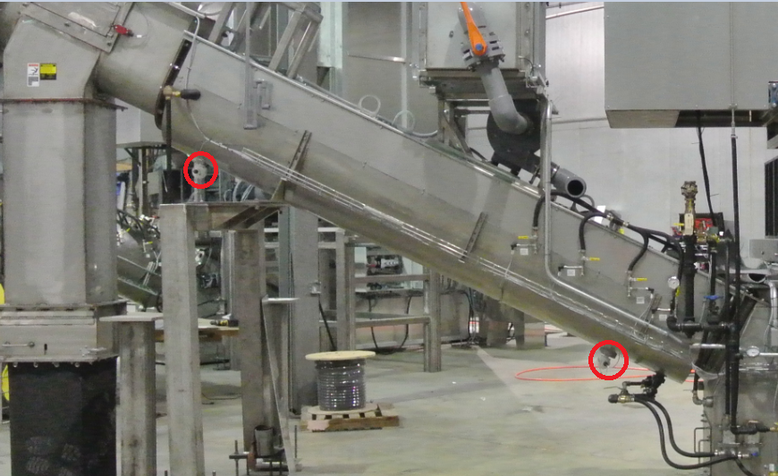
Spore Testing
RTD’s (temperature sensing devices) are located at the top and bottom of the auger
These take real time temperatures of the waste as it is being treated

Slide 28
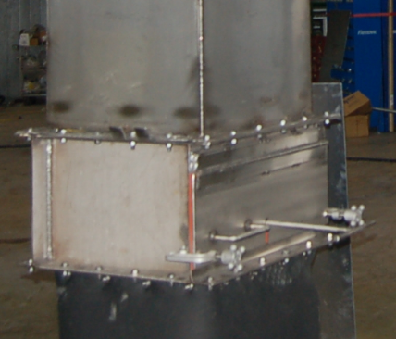
Spore Testing
The egg will then be recovered at the catch grate above the compactor and will be very hot
Wearing PPE, open the hot egg and remove the SCBi’s
The SCBI is then incubaged and checked with a color test. Results are kept in a log on the premisis

Slide 29
Spore Testing
Most states requires 1 test every 40 hours of operation. Check the regulations in your state for required frequency of testing
BioSAFE recommends testing with SCBI’s prior to removing the full 1 solid waste compactor
Testing frequency shall not be less than what is required by your individual state regulations

Slide 30
Test Log Example
Inspection Day
Day 1 Day 2 Day 3
Technician Name: Bob Smith
Test Date:
Starting Hour meter reading
Compactor:
Time SCBI is introduced:
Time SCBI exits the system:
SCBI Lot #:
Temperature Readout:
Ending Hour Meter Reading:
Treated G= Growth/NG=No Growth
Control Growth:
5/1/14
1478
#1
13:30
15:00
123
215°F
1480
NG NG NG
G G G

Slide 31
General Maintenance
STI Series 2000
  Electrical - 480V, 3PH, 60 Hz, 150 A
  Steam - 400 lbs per hour @ 14 PSIG max 2” NPT
  Drain - 4” Trapped drain
  Water – 40 PSIG 10GPM ¾” NPT
  Vents – 8” OD to outside, 4” OD to outside
  Data – Ethernet CAT5 with VPN access and static IP address

Slide 32
General Maintenance
Maintenance schedule is found in the Operator’s Manual
General maintenance schedule
  Check shredder oil and grease shredder bearings daily
  Check shredder screen weekly
  Grease Lower auger bearing 1 time/month
  “Rod-out” steam injectors weekly
  Change reducer oil semi-annually

Slide 33
General Maintenance Questions
What happens if the dumper is stuck in the up position?
  Use the dumper down button to lower the lift
Why are large pieces coming from the unit?
  The shredder screen is in need of repair
What happens when the compactor is full?
  The system will stop and not dump any more waste.
What happens when the cutters wear?
  The cutters normally have .005” clearance. When the clearance between cutters has a gap of .180”, replace the cutters.

Slide 34
Training Course - Test
      BioSAFE STI, LLC
      5750 W 80th St Indianapolis, IN 46278
Toll Free (888)858-8099 Tel. (317) 858-8099 Fax. (317) 858-8202
Home of the BioSAFE STI Series 2000
TRAINEE’S NAME: _________________________
(PLEASE PRINT CLEARLY)
  Date____/____/____

Slide 35
Operator Test
1.Where can you find a copy of the Operation & Maintenance Manual to review?
2.What is the name of the chemical used to prevent the waste from becoming a vector to pests?
3.What is the main treatment process of the RMW in the BioSAFE STI SERIES 2000 unit?
4.What is the MAX. operating pressure of the pressure vessel?
5.What does the touch-screen do for you?
6.When is it permitted to haul the compactor to the solid municipal waste site?(What conditions must have occurred to allow the processed waste to be transported to the landfill?)

Slide 36
Operator Test
7.How often does the unit require the on-going Q.A. testing in number of hours of machine operation?
8.What are MSDS sheets? (What does this stand for?)
9.What signifies that you are authorized to operate or maintain the equipment?
10.What specific section of the Federal Register were you supplied by STI which applies to bloodborne pathogens?
11.What is the name of the indicator organism used for on-going testing?
12.What does LOCK-OUT/TAG-OUT refer to?

Slide 37
Operator Test
13.What potential dangers exist in and around the machinery? List 4
14.What does spill containment refer to?
15.What section of the manual discusses procedures and instructions for testing the unit?
16.Once the waste is dumped into the machine there is no need to test the unit for proper operation. ______True ______False
17.Since the machine uses a chemical for odor control, there is no need to put on personal protective apparel prior to entering the unit to remove an obstruction in the shredder or hopper. ______True ______False

Slide 38
Operator Test
18.It is a good idea to disconnect all electrical power prior to service or welding on the machinery. _______True ______False
19.The operating temperature of the system is between 205 - 245° F. _______True ______False
20.The machinery is a perfect device that will never leave an intact needle from a syringe. ______True ______False.
21.What must the operator do if the lift is stuck in the up position (due to power example)?
22.What indicates that the unit is ready for the next load of waste?
23.What happens if the compactor becomes full?

Slide 39
Maintenance Test
NOTE: ONLY MAINTENANCE PERSONAL NEED TO CONTINUE WITH THE TEST AT THIS TIME
    24.What is the main voltage of the BioSAFE STI Series 2000 unit?_____VAC.
25.Where does a person find the recommended frequency
for service on the machinery?
26.What is the maximum operating temperatures of the system in degrees F?
27.Where do you find the service frequency for changing oil in
the main gear case of the shredder?

Slide 40
Maintenance Test
28.How often should you “Rod-out” steam injection lines?
29. How often should you change the gear lubrication is the auger gear reducer?
30.What detects the actual temperatures in the Auger?
31.If large pieces of waste are seen frequently coming from the unit, what may be the culprit?
32.What happens to cutters as they wear? (how is it normally noted)?
33.How often should you lubricate the bearings on the shredder?

